Slide 1

San Francisco Auto Rental (SAR)
Hemanth Matta
CSDA 6010 DATA ANALYTICS PRACTICUM

Slide 2
INTRODUCTION
Company Overview: San Francisco Auto Rental (SAR) is a transportation company offering short-term vehicle rentals to customers. It provides various ride booking options to cater to different customer needs.
Services Offered: SAR offers flexible ride options, including point-to-point, hourly rentals, and long-distance travel, aiming to provide convenient transportation solutions.
Business Challenge: Despite efforts like online booking, SAR faces ongoing ride cancellations, leading to customer dissatisfaction and lost revenue.

Slide 3
BUSINESS PROBLEM AND GOALS
Problem: SAR faces driver are cancelling the rides, leading to customer dissatisfaction.
Goal:
Find whether a new ride will get cancelled.
Find out what are the factors that are significant in the ride cancellations.

Slide 4
ANALYTICAL GOAL AND APPROACH
Predict cancellations: Build a model that should predict if the ride is likely to be cancelled in the future.
Identify patterns in cancellations: Look for trends and patterns, such as which types of bookings or timings are more likely to be canceled.
Approach:
Data preprocessing (handling missing values, feature engineering).
Build and evaluate machine learning models.
Measure model performance using key metrics (accuracy, sensitivity, specificity, precision, etc.).

Slide 5
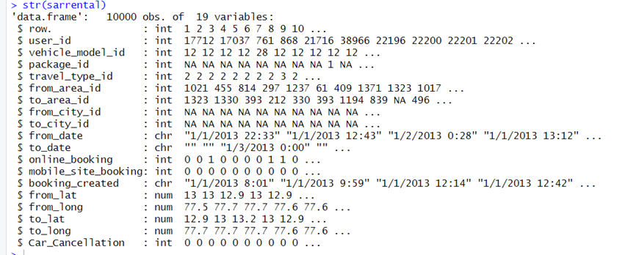
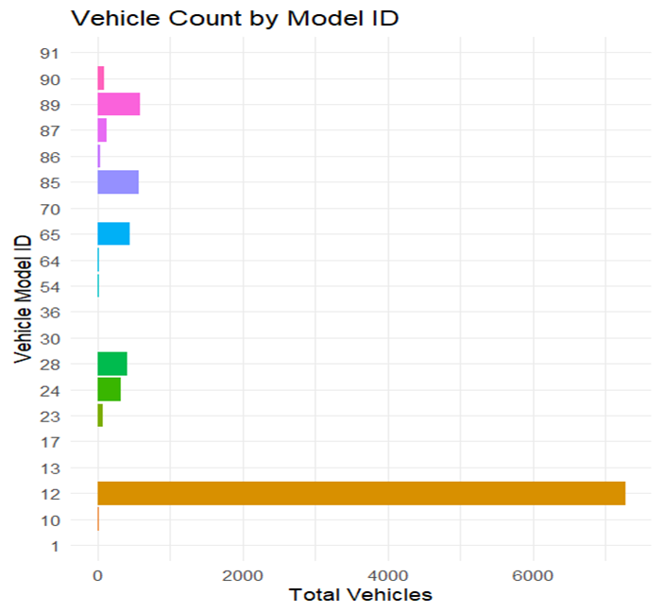
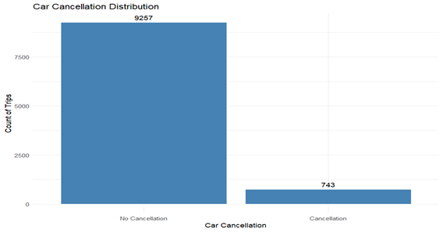
DATA EXPLORATION AND PREPROCESSING
The SAR company provided the data set having 10000 records with 19 attributes
•Total Users: 6,043 users.
One-Time Users: 5,841 users booked only 1 ride

Slide 6
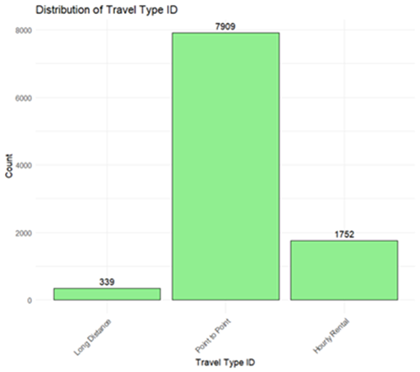
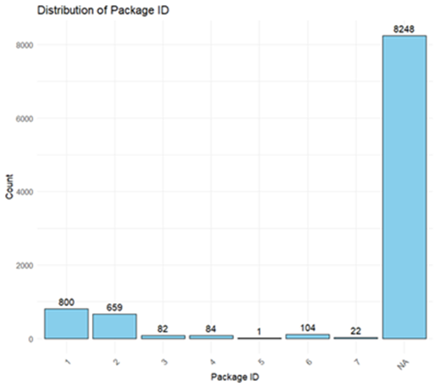
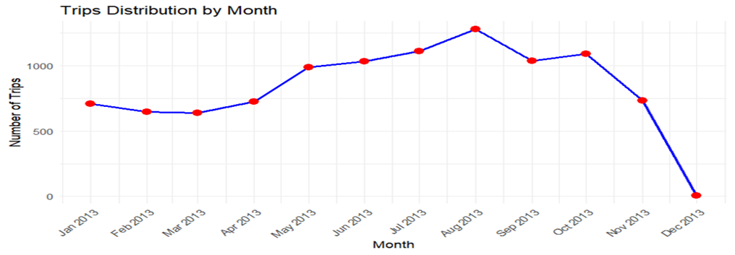
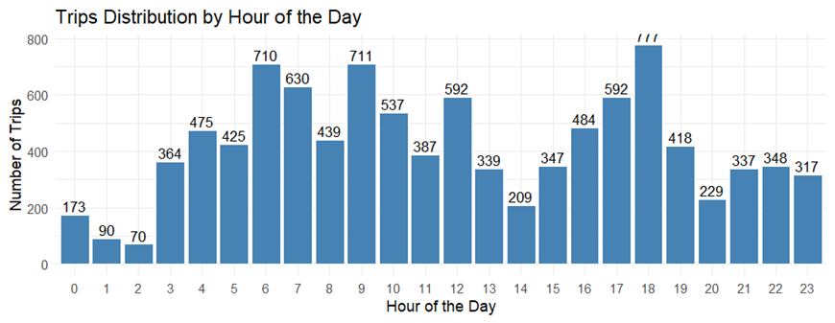
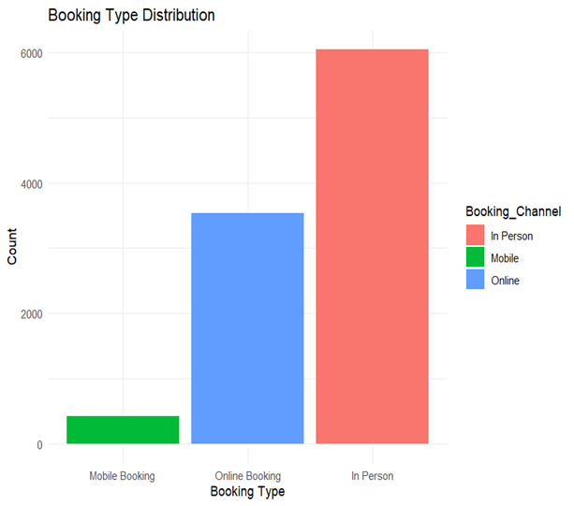
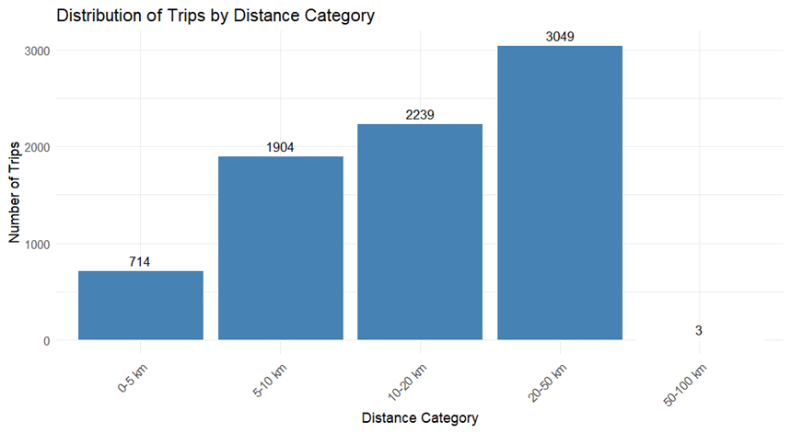
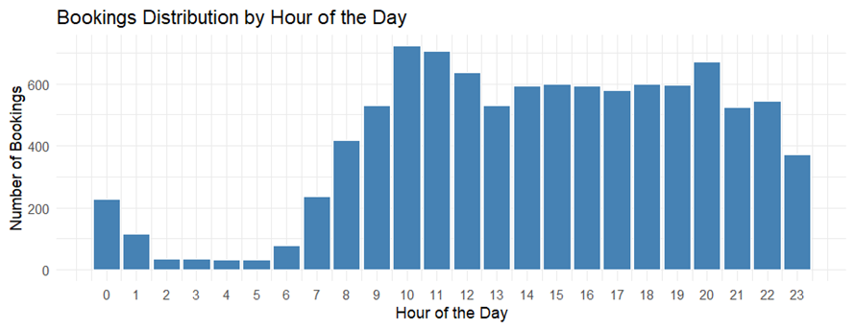

Slide 7
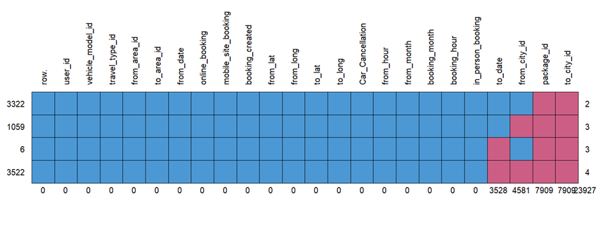
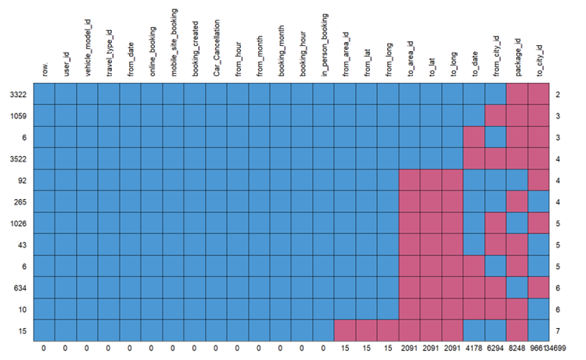
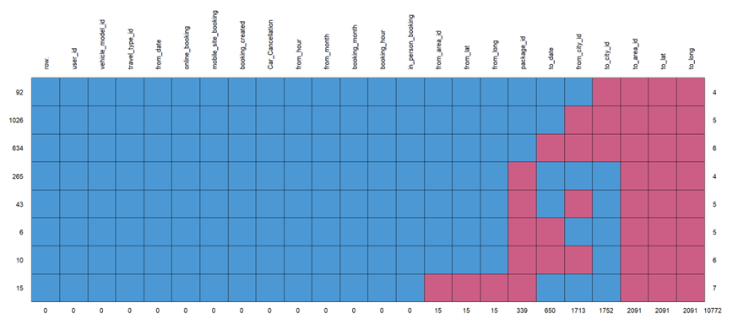
Missing values:
Point to point data
SAR Rental Dataset
Hourly and long distance

Slide 8
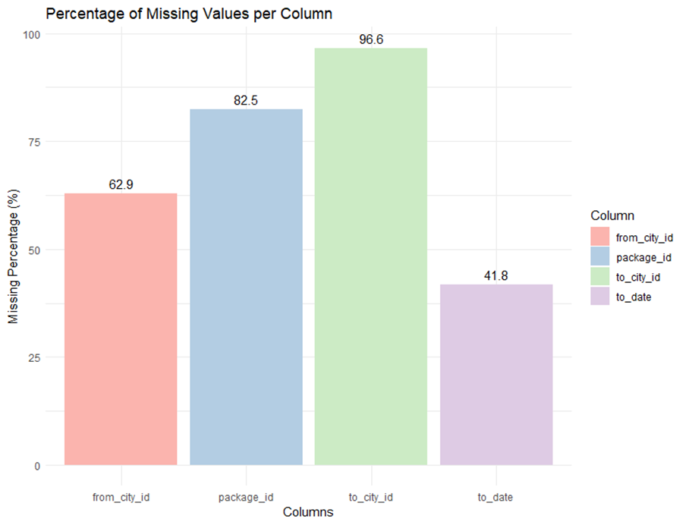
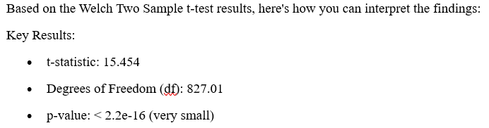
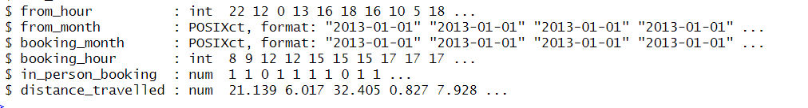
Handling of missing data:
Deletion:
Predictor analysis and relevancy
Continuous attributes:
Car cancellaton vs distance _travelled
Data transformation:
Distance Calculation
Date and Time Transformation
online_booking and mobile_site_booking

Slide 9
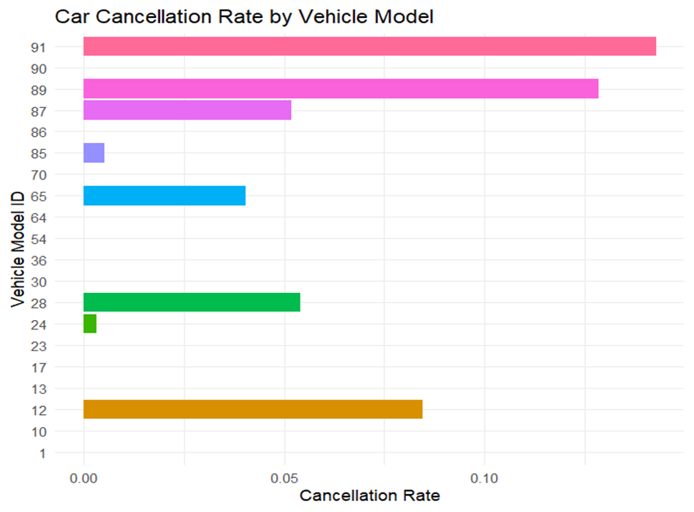
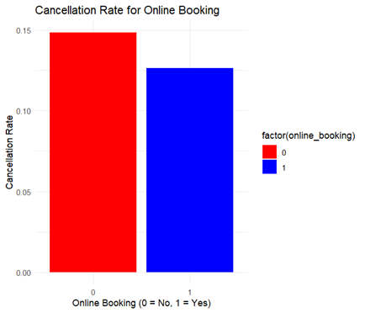
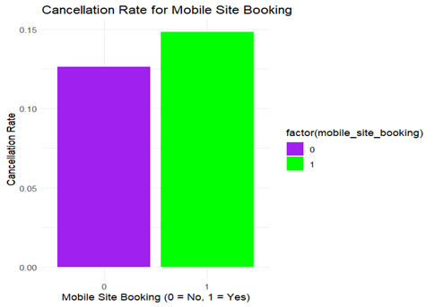
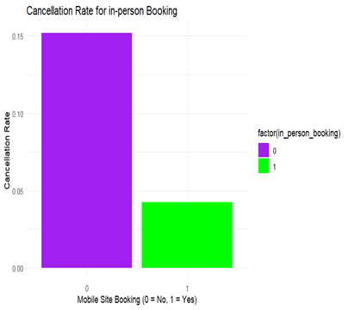
Predictor analysis and relevancy
Categorical attributes:
User_id vs car cancellation:
'user_id' variable exhibits high cardinality, with 5,841 users having only a single ride
From_area_id, to_area_id vs car_cancellation:
The high cardinality of from_area_id and to_area_id is a significant concern for including them in the dataset. With 523 unique from_area_id values and 480 unique to_area_id value

Slide 10
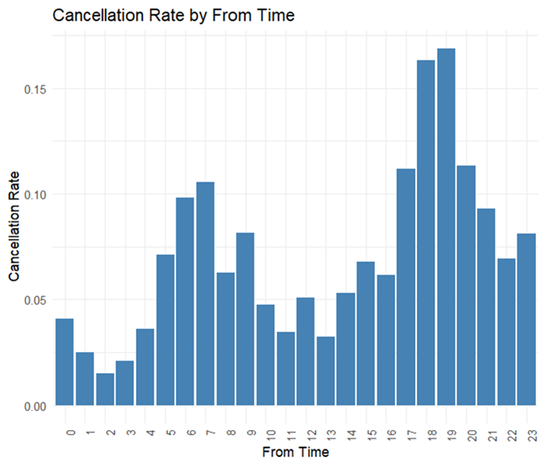
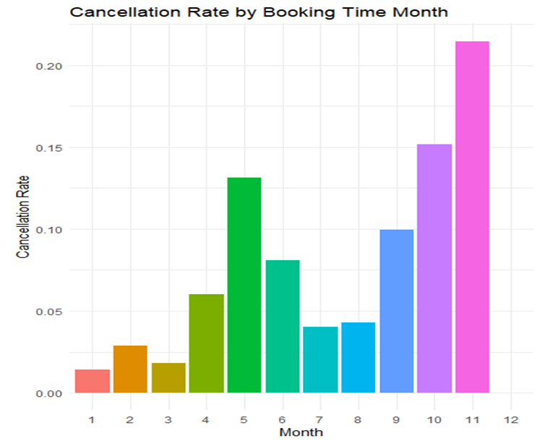
DIMENSION REDUCTION
Removing row_id and user_id:
Removing travel_type_id
Removing from_area_id and to_area_id:
Removing from_lat, from_long, to_lat, and to_long:
Removing booking_created, from_date:

Slide 11
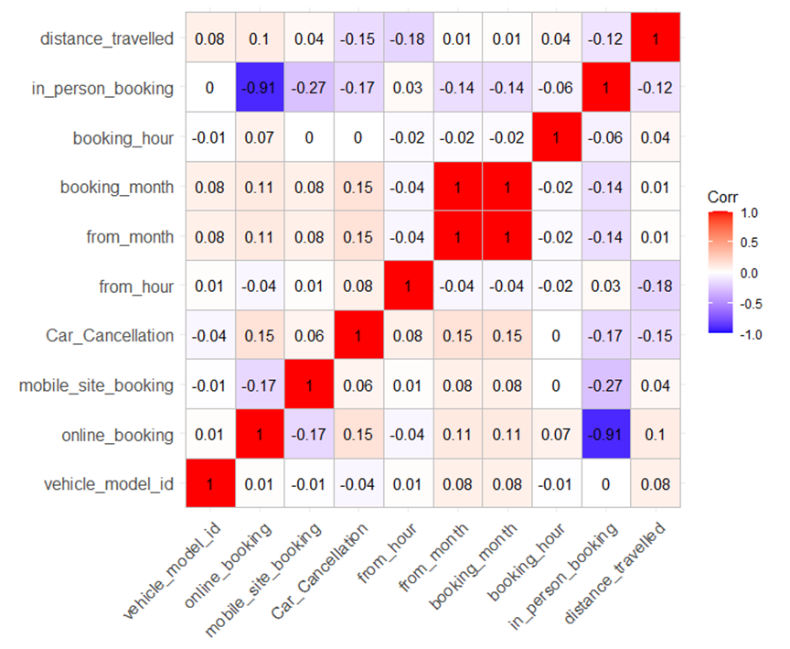
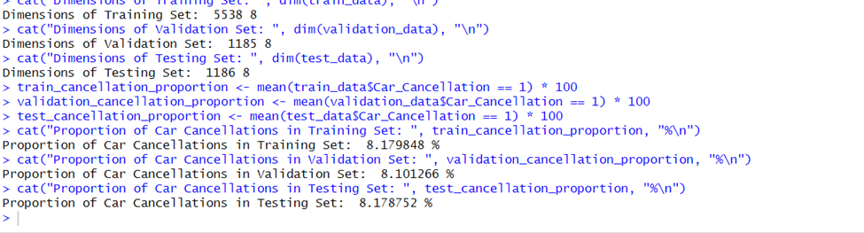
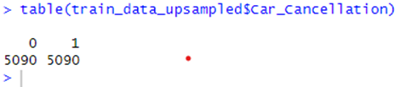
Model selection : Logistic Regression, Decision Tree, and Random Forest
DATA PARTITION:
A 70-15-15 split balances training, validation, and test
Correlation in between attributes:
Class Balancing:
Our training data consists of 5,090 records where car cancellation is "0" and only 466 records where car cancellation is "1,"
online_booking and in_person_booking show a very high negative correlation of -0.906
booking_month and from_month exhibit a perfect correlation of 1.000

Slide 12
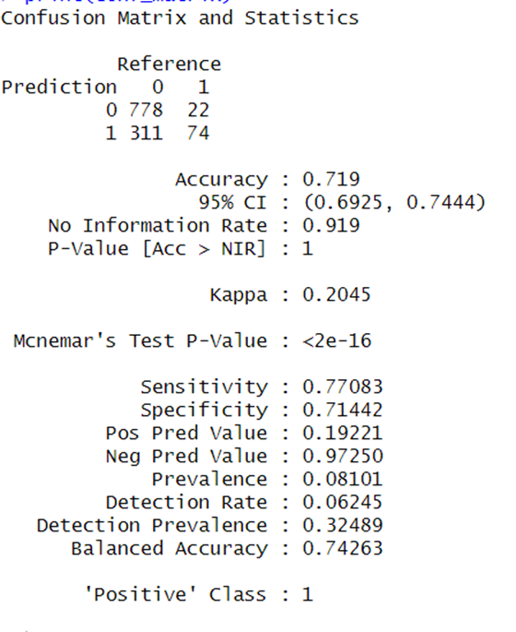
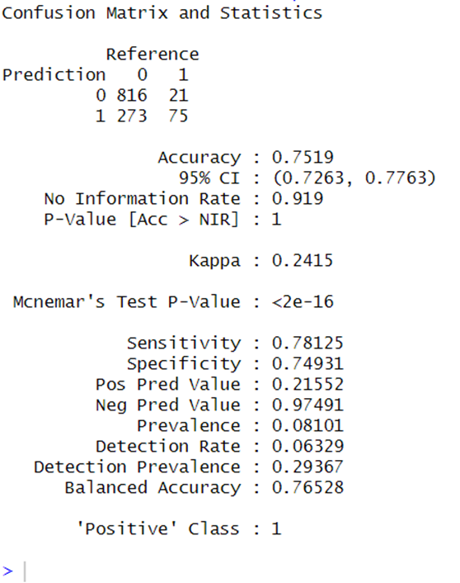
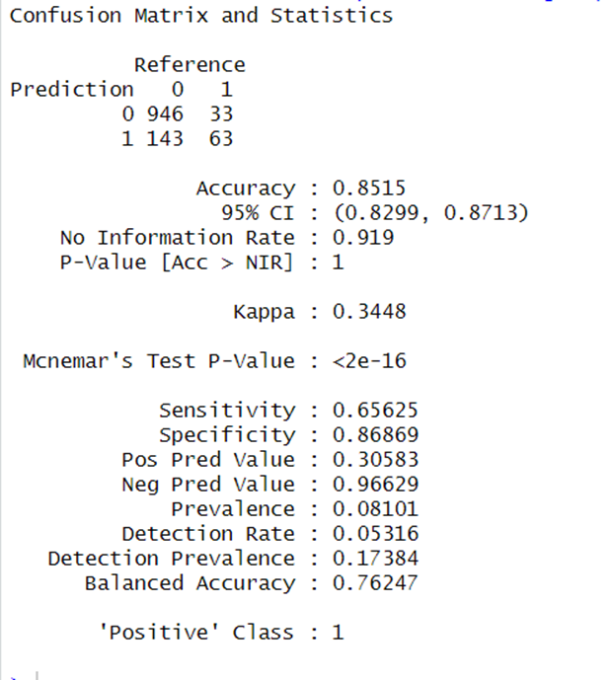
Decision tree:
Logistic regression:
Random forest:

Slide 13
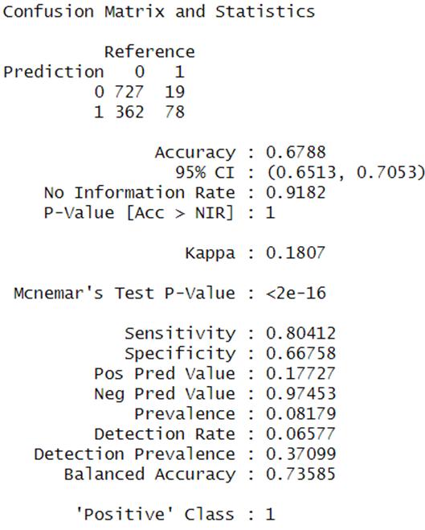
Model evaluation
To enhance the performance of the logistic regression model
The classification threshold was adjusted to 0.4 instead of the default 0.5
With a sensitivity of 80.41%, the model successfully detects a large proportion of actual cancellations
prioritizing higher sensitivity is a strategic decision for minimizing cancellations.

Slide 14
Observations and Conclusion
After improving the model, the sensitivity increased to 80.41%, which aligns with the analytical goal of accurately predicting ride cancellations
Key Factors Influencing Cancellations:
Booking Platform: Online Booking and Mobile Site Booking
Peak Cancellation Hours:
5 PM and 9 PM (from_time),
Distance Traveled: Longer distances correlate with higher cancellation rates

Slide 15
Thank you

